Slide 1

Efficient Keyboard Typing
Tips and Tricks to Boost Productivity
Unlocking the Power of Your Fingers
Prepared & Presented By: Obaydul Hasan Nayeem

Slide 2
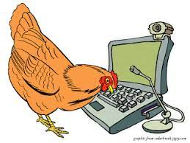
Why Need Typing Skill?
If not have,
Reduced Productivity
Increased Errors
Poor Time Management
Physical Discomfort
Difficulty in Collaboration
Lower Employability
Notes:
Reduced Productivity: Without good typing skills, it can take much longer to complete assignments, projects, and other tasks, which can lead to reduced productivity and lower grades.
Increased Errors: Poor typing skills can lead to mistakes, typos, and errors in your code and other documents. This can result in a lower quality of work and negatively impact your academic and professional performance.
Poor Time Management: Inefficient typing skills can lead to poor time management, as it takes longer to complete tasks. This can lead to missed deadlines and reduced performance.
Physical Discomfort: Poor typing skills can lead to physical discomfort, such as strain on the hands, wrists, and fingers. This can lead to repetitive strain injuries, which can be painful and negatively impact your ability to work.
Difficulty in Collaboration: Without good typing skills, it can be difficult to collaborate effectively with others. Poor communication and misunderstandings can arise, leading to project delays and reduced productivity.
Lower Employability: Not having good typing skills can lower your employability, as many employers require employees to have strong typing skills. This can limit your job opportunities and reduce your chances of professional success.

Slide 3

Benefits of Good Typing Skill: As a CSE Student
Increased Productivity
Improved Accuracy
Better Focus
Reduced Fatigue
Improved Communication
Competitive Advantage
Notes:
Increased Productivity: Good typing skills can help you complete your assignments and projects more quickly and efficiently. As a result, you can save time and move on to other tasks.
Improved Accuracy: Proper typing skills can help you type accurately, thereby reducing errors in your code and other documents. This can help you to present your work in a more professional and accurate manner.
Better Focus: Good typing skills can help you focus on your work by reducing distractions and helping you to maintain your train of thought while typing. This can help you to better manage your time and complete your work more efficiently.
Reduced Fatigue: Proper typing techniques can help you to reduce the strain on your hands and fingers, thereby reducing the likelihood of fatigue and repetitive strain injuries. This can help you to work more comfortably and for longer periods of time.
Improved Communication: Good typing skills can help you to communicate more effectively with your peers, professors, and colleagues. You can convey your ideas and thoughts more accurately and quickly, thereby improving your ability to collaborate and work in a team.
Competitive Advantage: Having good typing skills can give you a competitive advantage in the job market. Many employers consider typing skills to be an important factor in selecting candidates for job interviews.

Slide 4
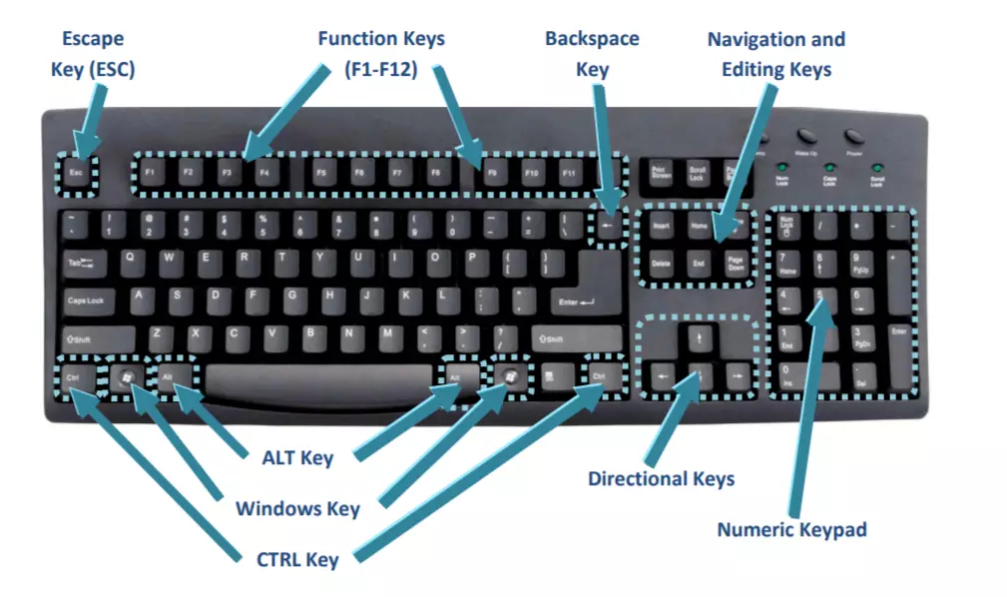
Anatomy of a Keyboard
Function Keys
Modifier Keys
Enter Key
Backspace Key
Space Bar
Arrow Keys
Numeric Keypad
Notes:
Keys: The keyboard has a set of keys, including alphabets, numbers, and symbols, arranged in a specific pattern. The layout of keys is based on the QWERTY layout, which is the most common keyboard layout in use today.
Function Keys: The keyboard also has function keys, typically located at the top row of the keyboard. Function keys (F1 to F12) are used to perform specific tasks or shortcuts in software applications.
Modifier Keys: The keyboard has modifier keys such as Shift, Alt, and Control. These keys, when pressed in combination with other keys, modify the behavior of the pressed key.
Enter Key: The Enter key, usually located at the right end of the keyboard, is used to confirm the input command or to start a new line.
Backspace Key: The Backspace key, usually located at the top right of the keyboard, is used to delete the previous character or space.
Space Bar: The space bar, located at the bottom center of the keyboard, is used to enter a space between words.
Arrow Keys: The arrow keys are used to move the cursor in different directions while typing.
Numeric Keypad: The numeric keypad is a separate section of the keyboard that contains numbers and basic math symbols. It is commonly used for numeric data entry.

Slide 5
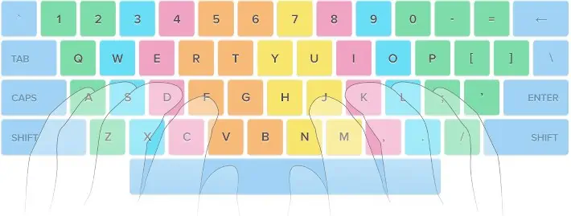
Typing Techniques
Two Finger Typing
Hunt and Peck
Touch Typing
Notes:
Touch Typing: Touch typing is a method of typing where you use all your fingers to type without looking at the keyboard. This technique involves placing your fingers on the home row keys and using a consistent typing rhythm to type quickly and accurately. Touch typing is the most efficient typing technique and is used by most professional typists.
Hunt and Peck: Hunt and peck is a typing technique where you use only one or two fingers to type, and you look at the keyboard while typing. This technique involves searching for the keys and then pecking at them with one or two fingers. Hunt and peck typing is much slower than touch typing and can cause strain and fatigue in your hands.
Two-Finger Typing: Two-finger typing is a technique where you use only two fingers to type, typically the index fingers. This technique is faster than hunt and peck typing but still slower than touch typing. Two-finger typing is not recommended for extended typing sessions as it can cause strain and fatigue in your hands.

Slide 6
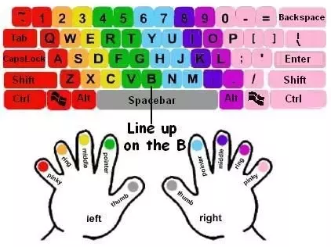
Thumb
Index Finger
Middle Finger
Ring Finger
Little Finger
Notes:
Proper hand placement is crucial for effective typing and to prevent strain or injury. Here are the details on how to achieve the correct hand placement on a standard keyboard:
Sit up straight: Position your chair so that your feet are flat on the ground and your back is straight. This will help prevent strain on your back and neck.
Position the keyboard: Position the keyboard directly in front of you and at a comfortable distance from your body.
Place your hands: Place your hands on the home row keys. The home row keys are the middle row of keys on the keyboard and include the letters A, S, D, F on the left hand and J, K, L, and ; on the right hand. Your fingers should be curved and relaxed.
Rest your thumbs: Rest your thumbs on the space bar, which is located at the bottom of the keyboard. Your thumbs should be relaxed and slightly bent.
Place your fingers: Place your remaining fingers on the other keys in the home row position. The index fingers should rest on the F and J keys, while the remaining fingers should rest on the keys adjacent to the home row.
Keep your wrists straight: Keep your wrists straight and level with the keyboard. Avoid bending your wrists up or down, as this can cause strain or injury.
Maintain a light touch: Type with a light touch and avoid hitting the keys too hard. This will help reduce strain and fatigue.
Avoid looking at the keyboard:
Try to type without looking at the keyboard. This will help you develop muscle memory and increase your speed and accuracy.
By maintaining proper hand placement, you can type more efficiently and with less strain on your hands, wrists, and arms. It may take some time to get used to the correct hand placement, but with practice, it will become more natural and comfortable.

Slide 7
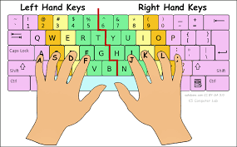
Notes:
Proper hand placement is crucial for effective typing and to prevent strain or injury. Here are the details on how to achieve the correct hand placement on a standard keyboard:
Sit up straight: Position your chair so that your feet are flat on the ground and your back is straight. This will help prevent strain on your back and neck.
Position the keyboard: Position the keyboard directly in front of you and at a comfortable distance from your body.
Place your hands: Place your hands on the home row keys. The home row keys are the middle row of keys on the keyboard and include the letters A, S, D, F on the left hand and J, K, L, and ; on the right hand. Your fingers should be curved and relaxed.
Rest your thumbs: Rest your thumbs on the space bar, which is located at the bottom of the keyboard. Your thumbs should be relaxed and slightly bent.
Place your fingers: Place your remaining fingers on the other keys in the home row position. The index fingers should rest on the F and J keys, while the remaining fingers should rest on the keys adjacent to the home row.
Keep your wrists straight: Keep your wrists straight and level with the keyboard. Avoid bending your wrists up or down, as this can cause strain or injury.
Maintain a light touch: Type with a light touch and avoid hitting the keys too hard. This will help reduce strain and fatigue.
Avoid looking at the keyboard:
Try to type without looking at the keyboard. This will help you develop muscle memory and increase your speed and accuracy.
By maintaining proper hand placement, you can type more efficiently and with less strain on your hands, wrists, and arms. It may take some time to get used to the correct hand placement, but with practice, it will become more natural and comfortable.

Slide 8

Notes:
Proper hand placement is crucial for effective typing and to prevent strain or injury. Here are the details on how to achieve the correct hand placement on a standard keyboard:
Sit up straight: Position your chair so that your feet are flat on the ground and your back is straight. This will help prevent strain on your back and neck.
Position the keyboard: Position the keyboard directly in front of you and at a comfortable distance from your body.
Place your hands: Place your hands on the home row keys. The home row keys are the middle row of keys on the keyboard and include the letters A, S, D, F on the left hand and J, K, L, and ; on the right hand. Your fingers should be curved and relaxed.
Rest your thumbs: Rest your thumbs on the space bar, which is located at the bottom of the keyboard. Your thumbs should be relaxed and slightly bent.
Place your fingers: Place your remaining fingers on the other keys in the home row position. The index fingers should rest on the F and J keys, while the remaining fingers should rest on the keys adjacent to the home row.
Keep your wrists straight: Keep your wrists straight and level with the keyboard. Avoid bending your wrists up or down, as this can cause strain or injury.
Maintain a light touch: Type with a light touch and avoid hitting the keys too hard. This will help reduce strain and fatigue.
Avoid looking at the keyboard:
Try to type without looking at the keyboard. This will help you develop muscle memory and increase your speed and accuracy.
By maintaining proper hand placement, you can type more efficiently and with less strain on your hands, wrists, and arms. It may take some time to get used to the correct hand placement, but with practice, it will become more natural and comfortable.

Slide 9
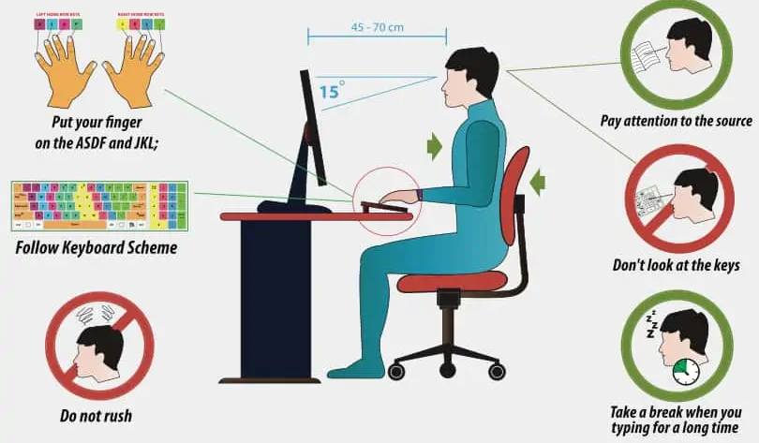
Proper Hand Placement
Proper sitting posture
Position the keyboard
Place your hand and fingers
Rest your thumbs
Keep your wrists straight
Maintain a light touch
Avoid looking at the keyboard
Notes:
Proper hand placement is crucial for effective typing and to prevent strain or injury. Here are the details on how to achieve the correct hand placement on a standard keyboard:
Sit up straight: Position your chair so that your feet are flat on the ground and your back is straight. This will help prevent strain on your back and neck.
Position the keyboard: Position the keyboard directly in front of you and at a comfortable distance from your body.
Place your hands: Place your hands on the home row keys. The home row keys are the middle row of keys on the keyboard and include the letters A, S, D, F on the left hand and J, K, L, and ; on the right hand. Your fingers should be curved and relaxed.
Rest your thumbs: Rest your thumbs on the space bar, which is located at the bottom of the keyboard. Your thumbs should be relaxed and slightly bent.
Place your fingers: Place your remaining fingers on the other keys in the home row position. The index fingers should rest on the F and J keys, while the remaining fingers should rest on the keys adjacent to the home row.
Keep your wrists straight: Keep your wrists straight and level with the keyboard. Avoid bending your wrists up or down, as this can cause strain or injury.
Maintain a light touch: Type with a light touch and avoid hitting the keys too hard. This will help reduce strain and fatigue.
Avoid looking at the keyboard:
Try to type without looking at the keyboard. This will help you develop muscle memory and increase your speed and accuracy.
By maintaining proper hand placement, you can type more efficiently and with less strain on your hands, wrists, and arms. It may take some time to get used to the correct hand placement, but with practice, it will become more natural and comfortable.

Slide 10
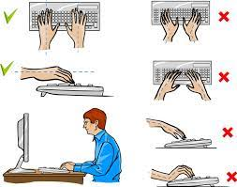
Common Typing Mistakes
Misspelling words
Incorrect finger placement
Incorrect use of shift key
Typing the wrong keys
Not using the spacebar
Typos
Notes:
Misspelling words: This is one of the most common mistakes that people make while typing. It can be caused by typing too fast, not paying attention to the keys, or simply not knowing how to spell a word.
Incorrect finger placement: Another common mistake is incorrect finger placement on the keyboard. Typing with the wrong fingers or using the wrong hand to reach certain keys can slow down your typing speed and make it harder to type accurately.
Incorrect use of shift key: The shift key is used to type uppercase letters and symbols. However, some people may use it incorrectly or forget to use it altogether. This can result in incorrect capitalization or missing important symbols.
Typing the wrong keys: Sometimes, you may accidentally hit the wrong key while typing. This can be caused by poor hand-eye coordination or not being familiar with the keyboard layout.
Not using the space bar: Many people forget to use the space bar between words, resulting in run-on sentences or improperly formatted text.
Typos: Typos occur when you type a word that is spelled correctly but is not the word you intended to type. This can be caused by typing too quickly or not proofreading your work.

Slide 11
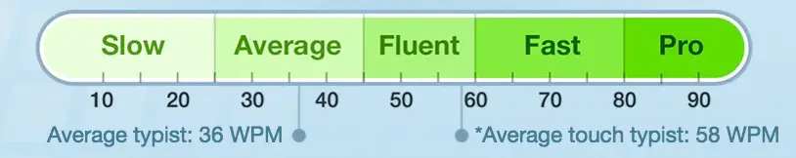
Typing Speed and Accuracy

Slide 12
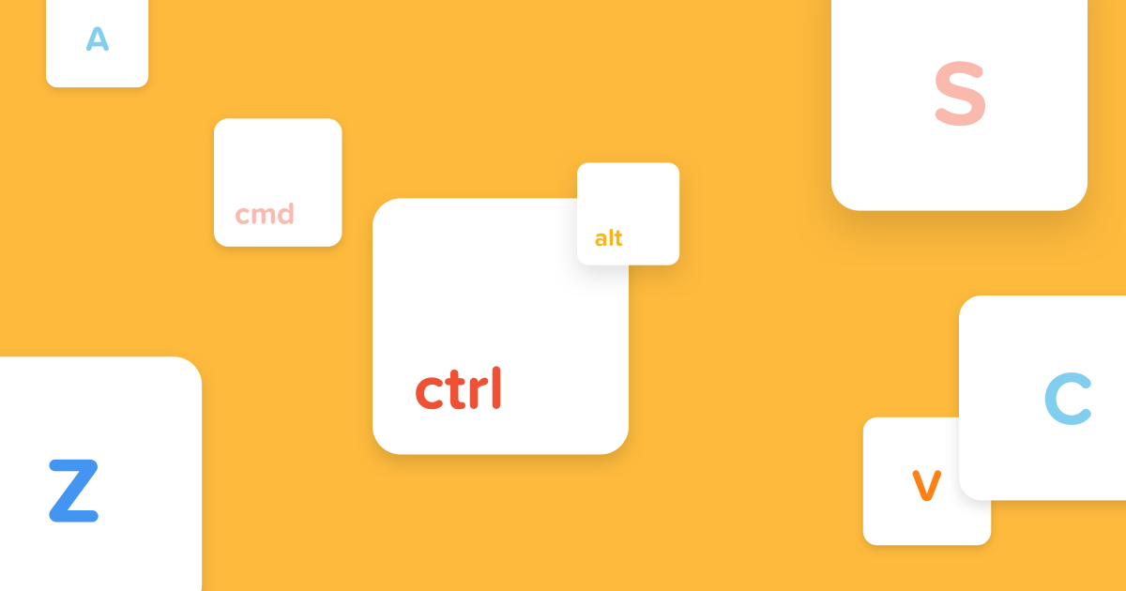
Keyboard Shortcuts
Ctrl + C: Copy selected text
Ctrl + V: Paste copied text
Ctrl + X: Cut selected text
Ctrl + A: Select all text in a document
Ctrl + Z: Undo the last action
Ctrl + Y: Redo the last undone action
Ctrl + F: Find text in a document
Ctrl + S: Save the current document
Ctrl + N: Open a new document
Alt + Tab: Changing window
F5: Refresh
F9: Codeblocks Run
F2: Codeblocks Logs

Slide 13
Tools and Resources
Keyboard: Avro Keyboard
Test Your Skill & Practice:
https://www.nitrotype.com/
TypeRacer - Play Typing Games and Race Friends
SpeedCoder Race | Multiplayer Code Typing Game
TypingMaster 11 - The Best Typing Tutor for Windows
Notes:
avroyc

Slide 14

Any Question?

Slide 15


